Slide 1

Review #1
(Literature Survey)
Project Title : Emotion Based Music Recommendation System
Project Team with SRN : Mridvi Sharma PES1UG21CS343
N Shreelekha PES1UG21CS353
Aditi M PES1UG21CS901

Slide 2
Paper 1
Title | Music Recommender System Using ChatBot
Author | Shivam Sakore, Pratik Jagdale, Mansi Borawake, Ankita Khandalkar
Abstract | This project implements a text-based music recommendation system that analyzes the user's text tone to suggest music matching their mood. The system utilizes IBM Analyser to determine the user's mood from their text and Last.FM API to recommend songs accordingly.The goal is to create a desktop application for reliable mood-based music recommendations.
Architecture | The system's architecture for a Music Recommendation chatbot involves a frontend displaying the user interface and reflecting conversations. On the server side, it employs the IBM tone analyzer to analyze user conversation and the Last.FM API to recommend songs based on detected emotions. The chatbot interacts with users, while Python serves as the primary programming language.
Model/dataset | The paper utilizes the Thayer mood model, derived from Bhar (2014), to classify music based on mood, categorizing songs by energy and stress levels from happy to sad and calm to energetic. It discusses using the IBM Tone Analyzer to detect emotional, linguistic, and social tones in written text. The model integrates the Big Five personality traits and employs Support Vector Machine (SVM) for multi-label classification to predict text tone.
Critiques | Although the project discusses the potential for automatic detection of the user's mood, it does not elaborate on how this functionality would be implemented or integrated into the chatbot system.
Conclusion | The paper introduces a comprehensive chatbot-based music recommender system, emphasizing personalized content and the role of human-computer interaction in emotion recognition. It integrates the IBM Tone Analyzer and Last.FM API for mood-based recommendations.

Slide 3
Paper 2
Title | A Hybrid Approach To Music Recommendation Using Sentiment Analysis
Author | Mr. Deepak Rao Khadatkar, Muskan Verma,Riya Lall,Preeti Verma
Abstract | The paper proposes a personalized music recommendation system based on sentiment analysis to address the lack of customization in existing systems. It aims to assist users in selecting music based on their sentiments, moods, and activity settings, recognizing music's impact on relaxation, mood control, and stress relief for mental and physical well-being in everyday circumstances.
Architecture | The architecture used in the paper is a hybrid approach to music recommendation system that combines the advantages of collaborative filtering with content-based filtering. The paper also uses sentiment analysis to enhance the recommendation system. The backend is developed using Python and Django framework, while the frontend is created using HTML, CSS, and JavaScript. The paper provides a detailed discussion of the implementation and user interface of the recommender system, as well as the future scopes and conclusion.
Dataset/model | The paper does not explicitly mention the specific dataset being used. However, it does discuss the use of sentiment analysis in the music recommendation system, which typically involves analyzing textual data from various sources such as social media, reviews, and blogs to determine the emotional content and make music recommendations based on the user’s emotional state
Critiqs | There is a need for improving the accuracy and precision of mood recognition, expanding the database of songs to better match emotions, and making the recommendation system more specific to the user's context, such as time of day and activity.
Conclusion | This paper proposes a music recommender system that uses sentiment analysis to personalize recommendations. It combines user-supplied music tags with automatically extracted acoustic data to suggest music. The system aims to address music choice overload, promote emotional and physical well-being, and improve work processes.

Slide 4
Paper 3
Title | Emotion Based Music Playlist Recommendation System using Interactive Chatbot
Author | Amrita Nair, Smriti Pillai, Ganga S Nair, Anjali T
Abstract | This research proposes an emotion-based music recommendation system using a chatbot. Unlike existing systems analyzing audio or user history, this system uses a chatbot to analyze the user's current emotions through conversation and recommends music based on their emotional state. It leverages the Spotify platform and API to generate personalized playlists.
Architecture | The paper describes the use of Convolutional Neural Network (CNN) models, combined with pre-trained models like VGG19 and Xception, which were trained on three different datasets. Each convolutional layer was followed by the ReLU activation layer and a CNN was used with LSTM and BiLSTM models because CNN is capable of abstracting features and lessening the complexity of training LSTM or BiLSTM. Results showed that CNN-BiLSTM performed better when compared to the rest of the models.
Dataset/model | The models used in the paper include LSTM, Bidirectional LSTM, and 1-D CNN, and they were trained on the Twitter dataset. The dataset used for sentiment training is the Twitter Dataset from Kaggle, which is a collection of around 25,000 tweets from Twitter and other websites. The tweets are classified into Positive, Negative, and Neutral.
Critiques | The chatbot currently questions the user from certain predefined domains like weather, sports, favorite music, etc. However, this approach may limit the scope of user engagement and the variety of topics covered.
Conclusion | This project built a music recommender system. A chatbot analyzes user emotions through conversation using three models (LSTM, Bi-LSTM, 1-D CNN). The best performing model, Bi-LSTM, classifies emotions as positive, negative, or neutral. Future work includes expanding emotional categories and adding more diverse questions to the chatbot for better user understanding and responses.

Slide 5
Paper 4
Title | Emotion aware Smart Music Recommender System using Two Level CNN
Author | Krupa K S, Ambara G , Kartikey Rai , Sahil Choudhury
Abstract | Music and mental health are deeply linked, with music demonstrably improving mood, reducing stress, and promoting well-being. However, existing music recommendation systems often neglect this crucial aspect. This project proposes "Viby," a novel system that leverages machine learning and NLP to curate music recommendations that cater to users' emotional states, aiming to enhance their mental well-being.
Architecture | Viby, a music recommendation system, leverages a layered architecture. The user interacts through a ReactJS frontend, while the backend, powered by Node.js and Python, stores data in MongoDB. Viby analyzes user emotions via a chatbot and recommends music based on mood using various engines, including content-based filtering and mood-specific playlists. This architecture personalizes music recommendations based on the user's emotional state.
Dataset/model | The dataset used in the paper is a song dataset with a size of 12000, fetched from the Spotify Web API.The two main models used in the paper are the emotion and valence analyzer model, which recognizes the user's emotion and provides songs from the proximity of the recognized emotion.
Critiques | Data privacy measures for user details stored in MongoDB needs to be addressed.Limitations or biases associated with Spotify Web API song dataset are not specified.
Conclusion | Viby fills a critical gap in current music streaming options by offering emotion-specific recommendations to uplift users' mental well-being. With accurate mood detection and recognition, it provides accessible music therapy through personalized suggestions. Ongoing dataset improvements via content-based filtering ensure precise recommendations tailored to users' needs.

Slide 6
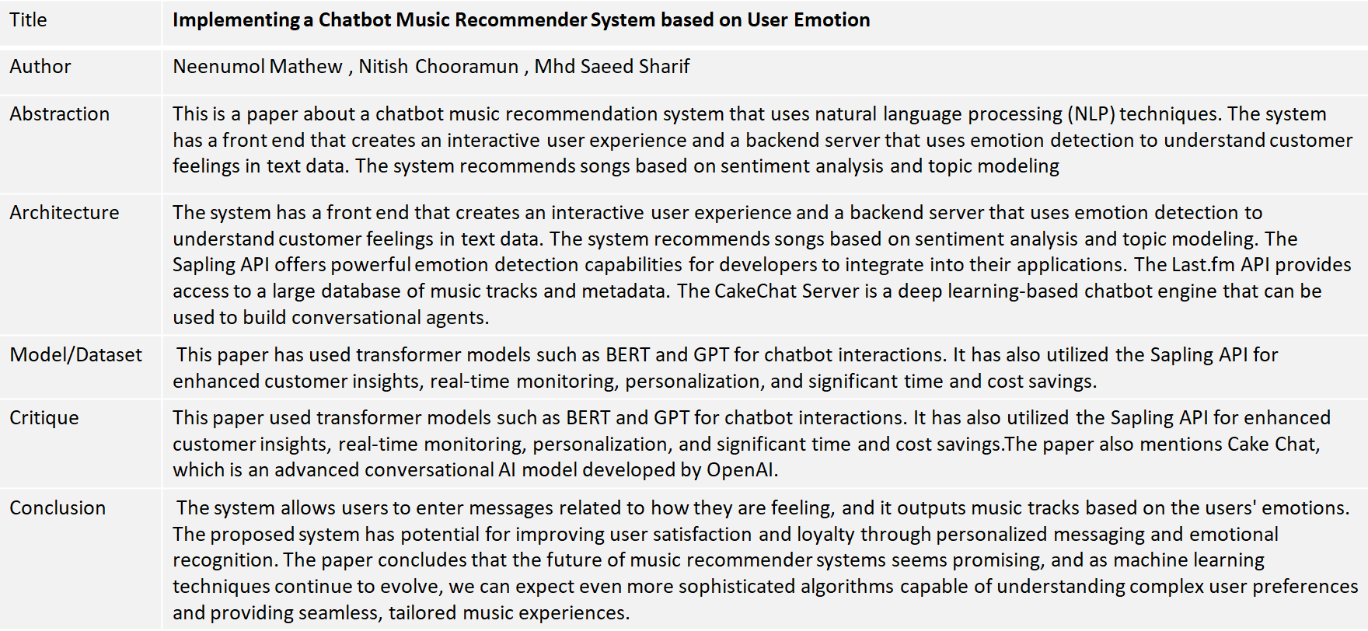
Paper 5

Slide 7
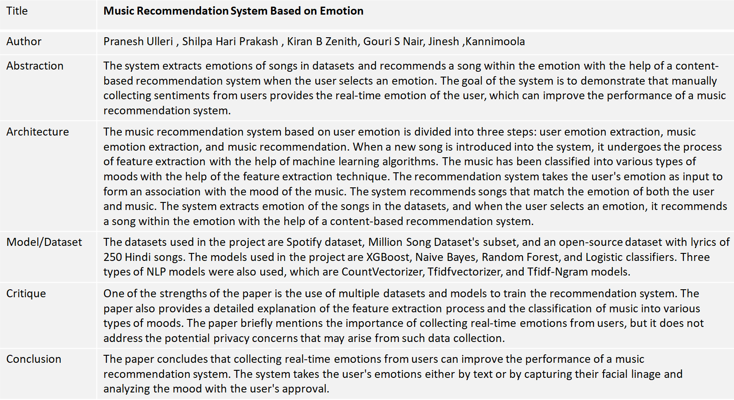
Paper 6

Slide 8
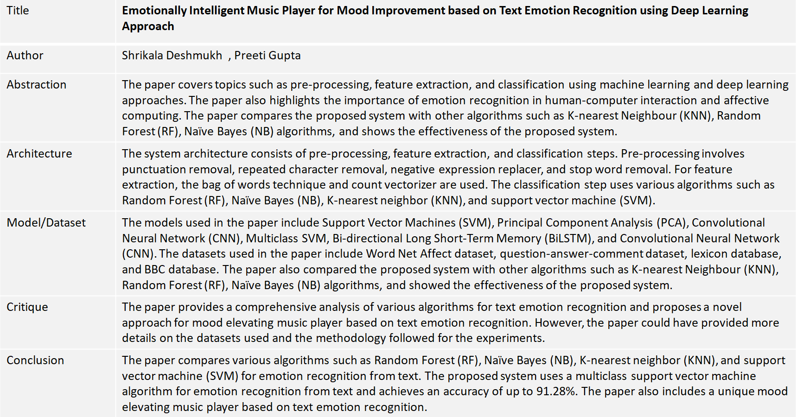
Paper 7 4

Slide 9
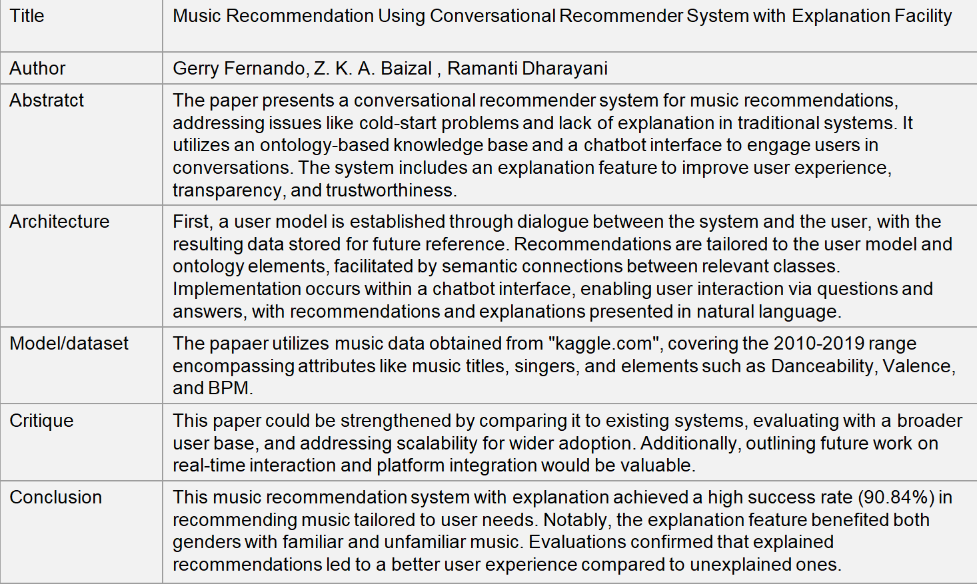
Paper 8

Slide 10
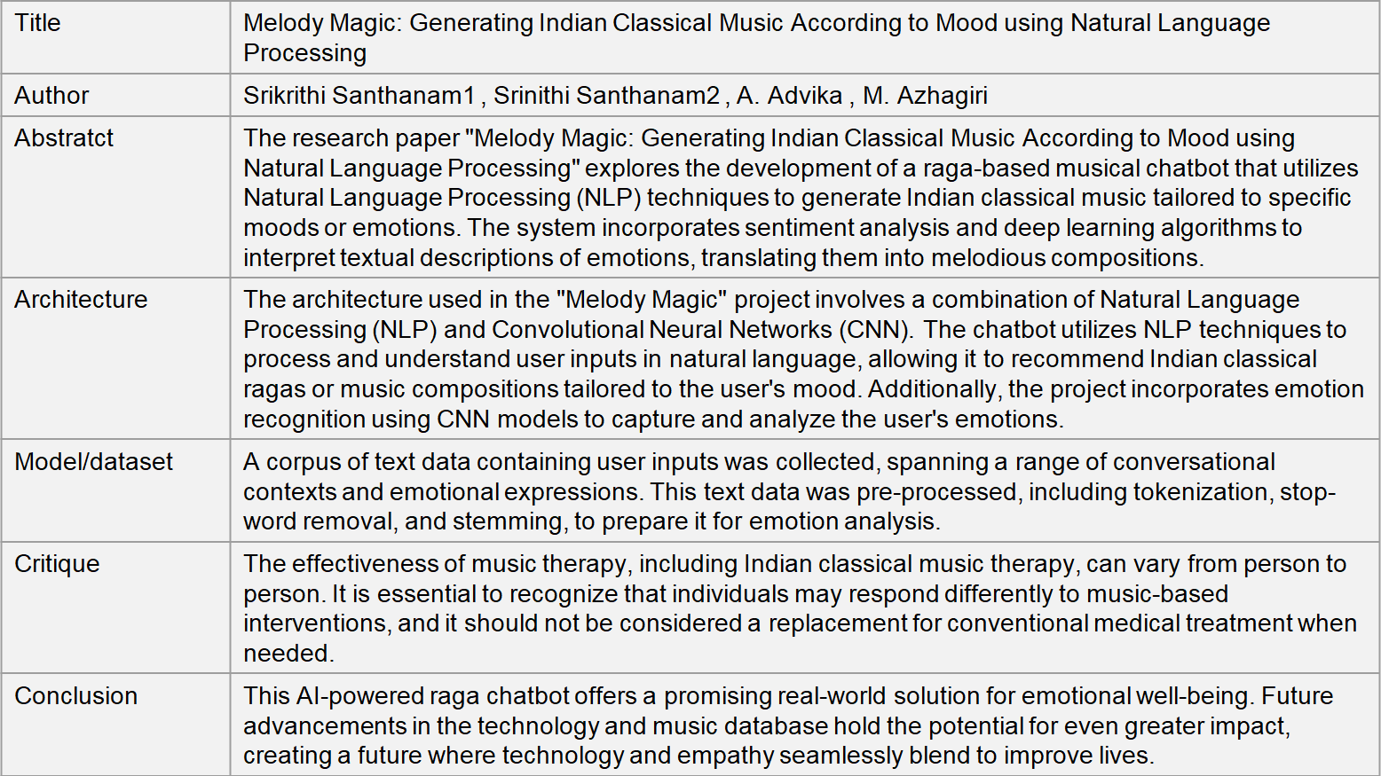
Paper 9

Slide 11
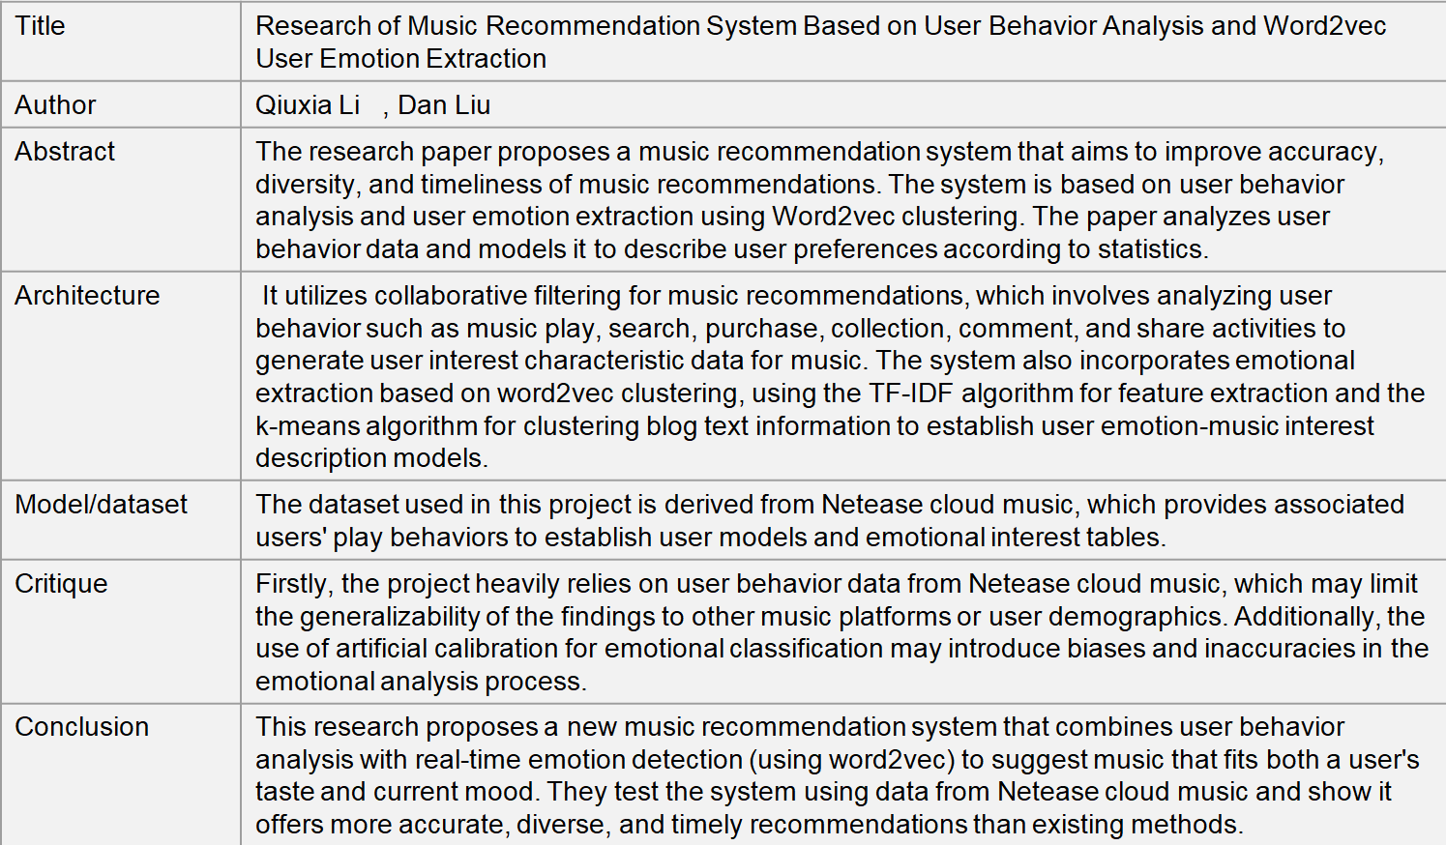
Paper 10

Slide 12
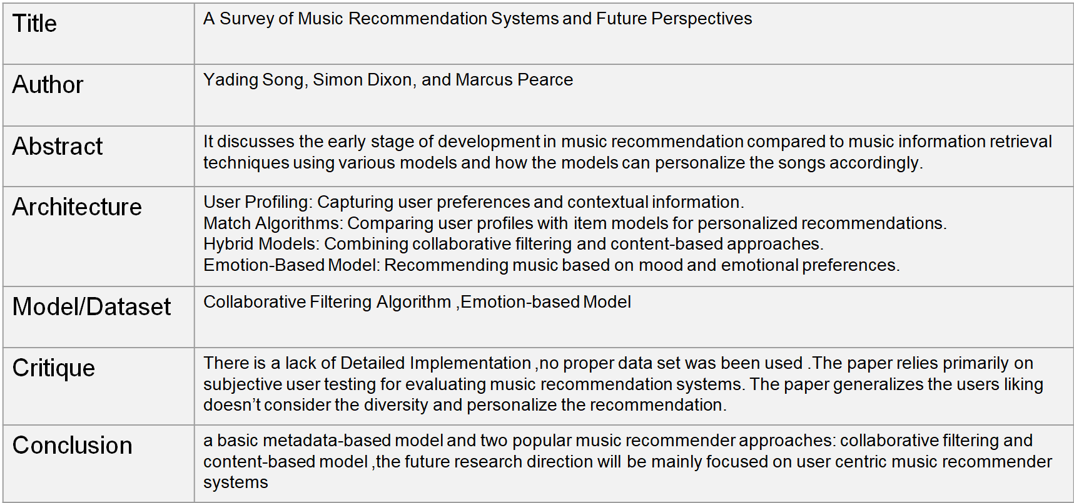
Paper 11

Slide 13
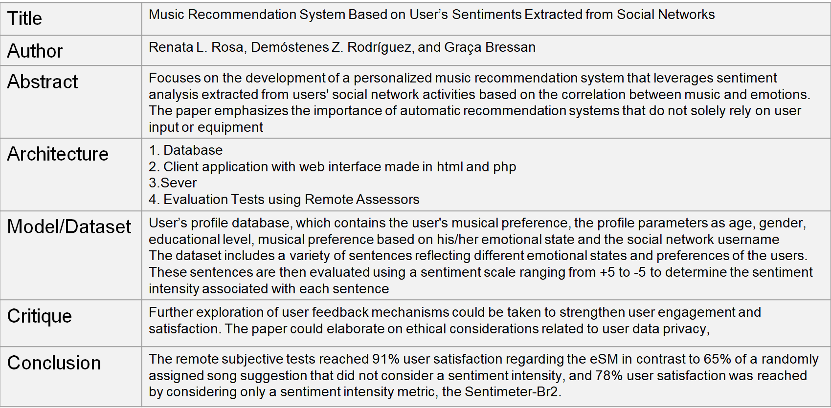
Paper 12

Slide 14
Title of the Project
References
Sakore, S., Jagdale, P., Borawake, M., & Khandalkar, A. (2021). Music Recommender System Using ChatBot.
Khadatkar, Mr Deepak Rao, et al. "A Hybrid Approach To Music Recommendation Using Sentiment Analysis." International Journal of Futuristic Innovation in Engineering, Science and Technology (IJFIEST) 1.1 (2022): 6-9.
Nair, Amrita, et al. "Emotion based music playlist recommendation system using interactive chatbot." 2021 6th international conference on communication and electronics systems (ICCES). IEEE, 2021.
Krupa, K. S., et al. "Emotion aware smart music recommender system using two level CNN." 2020 Third International Conference on Smart Systems and Inventive Technology (ICSSIT). IEEE, 2020.
Mathew, Neenumol, Nitish Chooramun, and Mhd Saeed Sharif. "Implementing a Chatbot Music Recommender System based on User Emotion." 2023 International Conference on Innovation and Intelligence for Informatics, Computing, and Technologies (3ICT). IEEE, 2023.
Ulleri, Pranesh, et al. "Music recommendation system based on emotion." 2021 12th International Conference on Computing Communication and Networking Technologies (ICCCNT). IEEE, 2021.
Deshmukh, Shrikala, and Preeti Gupta. "Emotionally Intelligent Music Player for Mood Improvement based on Text Emotion Recognition using Deep Learning Approach." International Journal of Intelligent Systems and Applications in Engineering 12.2s (2024): 294-302.
Fernando, Gerry, Z. K. A. Baizal, and Ramanti Dharayani. "Music recommendation using conversational recommender system with explanation facility." 2021 International Conference on Data Science and Its Applications (ICoDSA). IEEE, 2021.
Santhanam, Srikrithi, et al. "Melody Magic: Generating Indian Classical Music According to Mood using Natural Language Processing.“
Li, Qiuxia, and Dan Liu. "Research of music recommendation system based on user behavior analysis and word2vec user emotion extraction." Advances in Intelligent Systems and Interactive Applications: Proceedings of the 2nd International Conference on Intelligent and Interactive Systems and Applications (IISA2017). Springer International Publishing, 2018.
Song, Yading, Simon Dixon, and Marcus Pearce. "A survey of music recommendation systems and future perspectives." 9th international symposium on computer music modeling and retrieval. Vol. 4. 2012.
Rosa, Renata L., Demsteneso Z. Rodriguez, and Graça Bressan. "Music recommendation system based on user's sentiments extracted from social networks." IEEE Transactions on Consumer Electronics 61.3 (2015): 359-367.

Slide 15
Thank You

